Slide 1


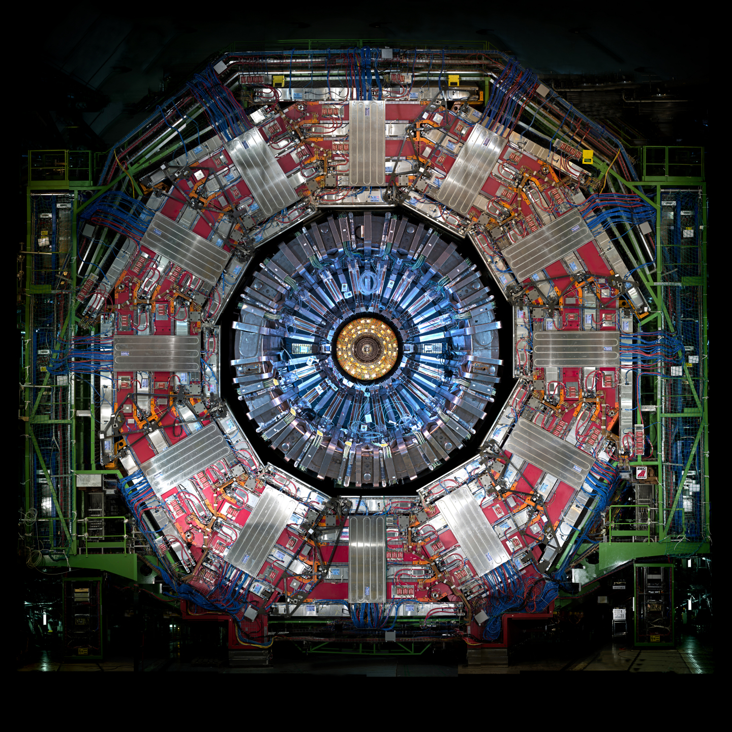
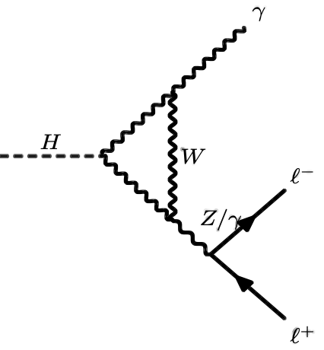
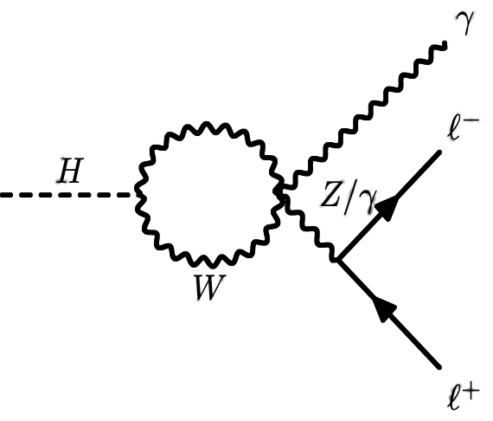
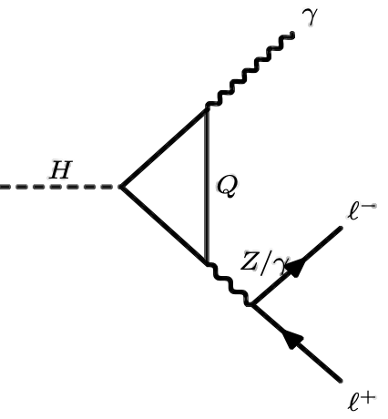
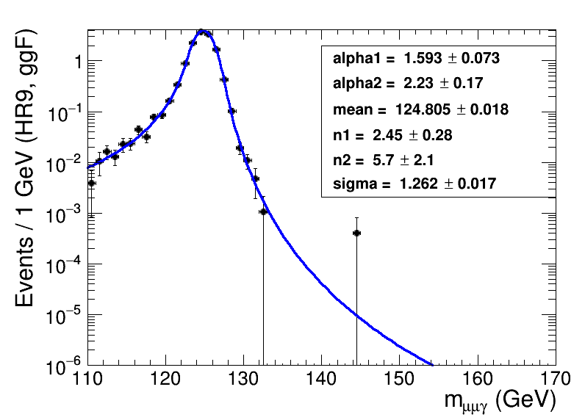
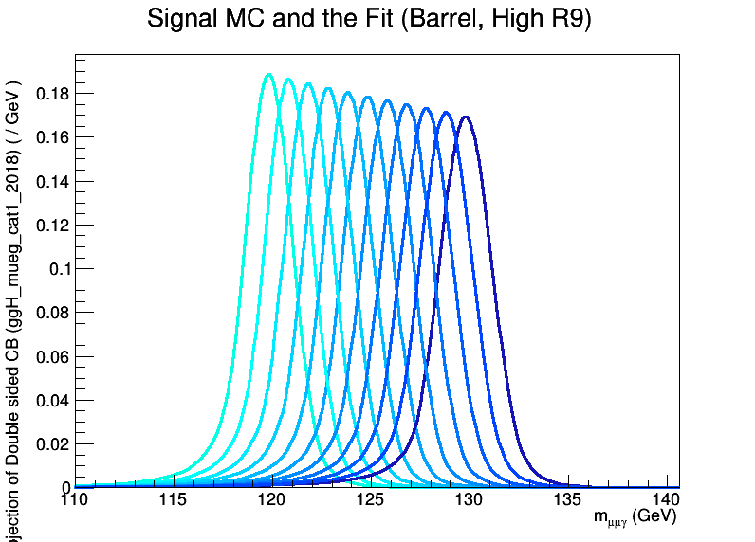

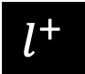

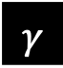


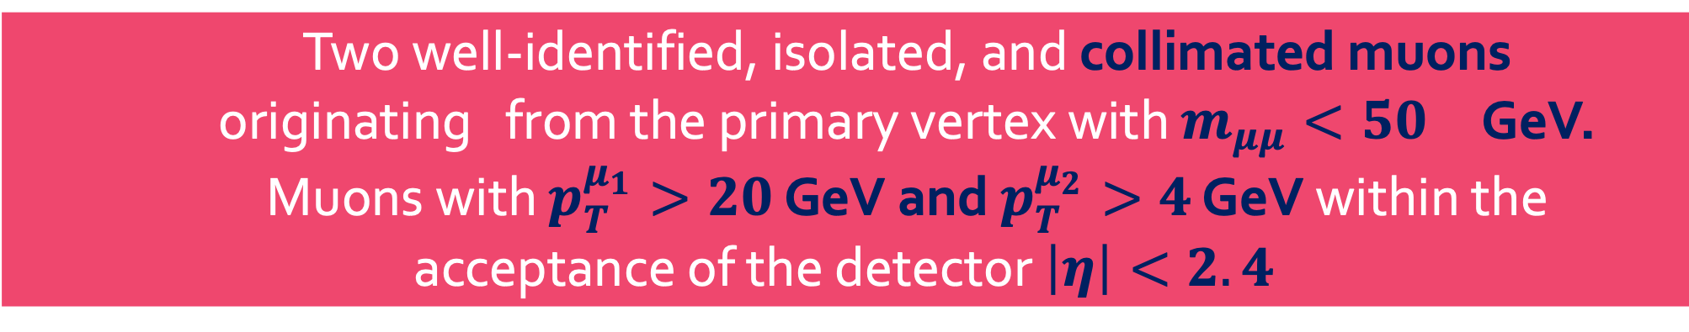

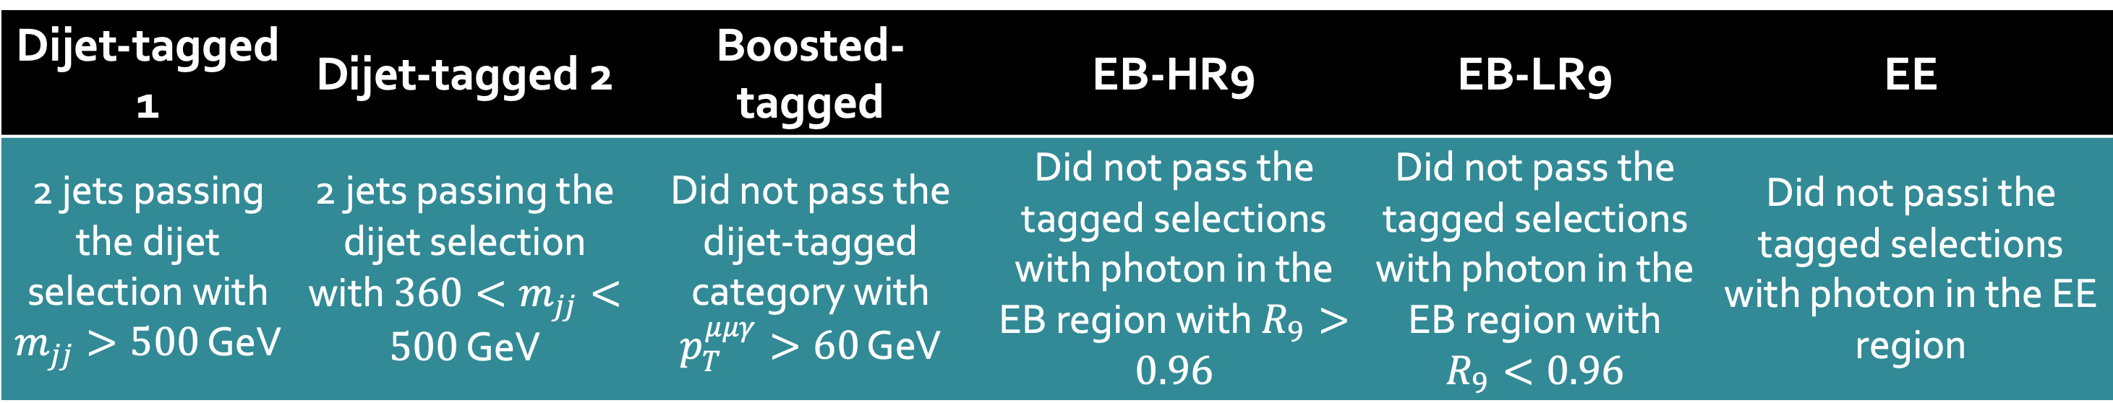

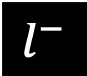
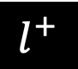
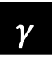



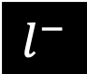

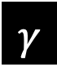




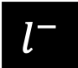





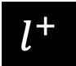


Search for
$$H→γ^{∗}γ→μμγ$$
with full LHC Run-2 data collected by the CMS detector
with full LHC Run-2 data collected by the CMS detector
________________________________________________________________________
John Adams Villamoran, Cheng-Han Wu, Hao-Ren Jheng, Chia-Ming Kuo, and Saba Taj
for the CMS Collaboration
Department of Physics & Center for High-Energy and High-Field Physics, National Central University, Chungli, Taiwan
with full LHC Run-2 data collected by the CMS detector
Abstract
Rare decays of the Higgs, such as the loop-induced Dalitz process, 𝐻 → 𝛾∗𝛾, provide opportunities to test the Standard Model (SM) as well as multiple theories Beyond the Standard Model (BSM). The topic to be presented discusses the search for the 𝐻 → 𝛾∗𝛾, where an internal conversion of a virtual photon to two muons occurred. Data used in the analysis was collected by the CMS experiment at the LHC from proton-proton collisions with a center-of-mass energy of 13 TeV during the full Run-2 period, corresponding to an integrated luminosity of 137 fb⁻¹.
Introduction
$$γ$$
$$γ$$
$$γ$$
Figure 1. Higgs Dalitz decay loop-induced Feynman diagrams.
$$γ$$
$$H$$
$$W$$
$$l^{−}$$
$$H$$
$$γ$$
$$l^{−}$$
$$H$$
$$Q$$
$$l^{−}$$
$$γ$$
$$W$$
$$γ$$
$$l^{+}$$
$$l^{+}$$
Rare Higgs decays in the Standard Model open up a lot of possibilities to investigate physics Beyond the Standard Model (BSM). The Dalitz sector of Higgs decays, $H→llγ$, are rare decays dominated by loop-induced processes, such as the $H→γ^{∗}γ$. This process may possibly be enhanced in some BSM theories, which makes it sensitive to new physics^{[1]}. Furthermore, the non-triviality of its angular correlations may result in a nonzero measurement of the forward-backward asymmetry, manifested through CP violation in the $H_{ll}$ effective coupling^{[2]}.
$$l^{+}$$
$$μ_{1}$$
$$μ_{2}$$
Event Selection & Categorization
$$μμ$$
Two well-identified, isolated, and collimated muons originating from the primary vertex with $m_{μμ}<50$ GeV. Muons with $p_{T}^{μ_{1}}>20$ GeV and $p_{T}^{μ_{2}}>4$ GeV within the acceptance of the detector $\left|η\right|<2.4$
CMS Work in progress
$$γ$$
Isolated and highly-energetic photons with $E_{T}^{γ}>33$ GeV within ECAL acceptance region $\left|η_{SC}\right|<2.5$ excluding the barrel-endcap transition region $1.4442<\left|η_{SC}\right|<1.566$
Figure 2. CMS detector cross-sectional view with arrows illustrating the final state signature of $H→γ^{∗}γ→μμγ$. Image taken from [3]
CMS Work in progress
$$H$$
Kinematic cuts: ${p_{T}^{μμ(γ)}}/{m_{μμγ}}>0.3$ and $ΔR\left(μ,γ\right)>1$ to suppress the dominant Drell-Yan backgrounds
Each event is binned according to the dimuon mass, exploiting the higher predicted cross-section for smaller masses. Each dimuon mass bin is then categorized into the following:
Figure 3. Signal distributions for the dimuon invariant mass (top) and the ratio between the photon and dimuon $p_{T}$ (bottom).
Work in progress
Dijet-tagged 1 | Dijet-tagged 2 | Boosted-tagged | EB-HR9 | EB-LR9 | EE
2 jets passing the dijet selection with $m_{jj}>500$ GeV | 2 jets passing the dijet selection with ${360<m}_{jj}<500$ GeV | Did not pass the dijet-tagged category with $p_{T}^{μμγ}>60$ GeV | Did not pass the tagged selections with photon in the EB region with $R_{9}>0.96$ | Did not pass the tagged selections with photon in the EB region with $R_{9}<0.96$ | Did not passi the tagged selections with photon in the EE region
Work in progress
Signal & Background Modeling
Results & Conclusion
Model the signal using events selected from dedicated signal samples simulating the $H→γ∗γ→μμγ$. A maximum-likelihood fit to the three-body invariant mass was performed using a Double-Sided Crystal Ball Function. The resulting fit parameters are then interpolated linearly to obtain the signal fits for the intermediate mass points.
The background is modeled using a data-driven approach. A maximum likelihood fit is performed on sideband region of the three-body invariant mass distribution of the data while blinding the signal region defined in the range $120<m_{μμγ}<130$ GeV. The background fit function is chosen from a list of candidate family functions. An f-test was done to choose a sufficient order for each family of functions. An uncertainty due to the choice of the fit function is assigned through the envelope method.
Work in progress
Work in progress
Work in progress
Figure 5. (Left) Final background model with signal histogram (enhanced by a factor of 5 for visualization). (Right) Combined expected upper limits on $σ/σ_{SM}$ for all years.
The derived expected upper limit on the ratio of the cross-section times branching with the Standard Model prediction ($σ/{σ_{SM}}$) for $H→γ^{∗}γ→μμγ$ at 95% confidence level is $\sim 1.18$. This level of sensitivity was achieved by exploiting the special signatures of the decay as well as the multiple categories implemented based on the dimuon invariant mass.
Figure 4. (Top) Signal fit for a 125-GeV Higgs boson produced with gluon-gluon fusion in the EB-High R9 category for 2018. (Middle) Signal fit interpolation assuming different Higgs boson masses (120-130 GeV) for 2018 EB-High R9 category. (Bottom) Fit functions chosen by the f-test for 2018 data in the EB-High R9 category.
References
[1] M. Carena, I. Low, and C. E. M. Wagner, “Implications of a modified higgs to diphoton decay width”, Journal of High Energy Physics 2012 (Aug, 2012) 60,
[2] A. Y. Korchin and V. A. Kovalchuk, “Angular distribution and forward-backward asymmetry of the higgs-boson decay to photon and lepton pair”, The European Physical Journal C 74 (Nov, 2014) 3141
[3] https://home.cern/science/experiments

